Slide 1













EDA of Data Science Salaries 2023
Team Members:
Deepshika
Lubik
Sabhyata

Slide 2

Dataset Overview &
EDA Goals
Dataset contains salaries of data professionals from around the world (2023).
Includes features like job title, experience level, company size, location, salary in USD.
EDA Goals:
Understand the structure and quality of the data.
Uncover patterns in salary distribution across roles, experience, and regions.
Detect anomalies and engineer meaningful features.

Slide 3
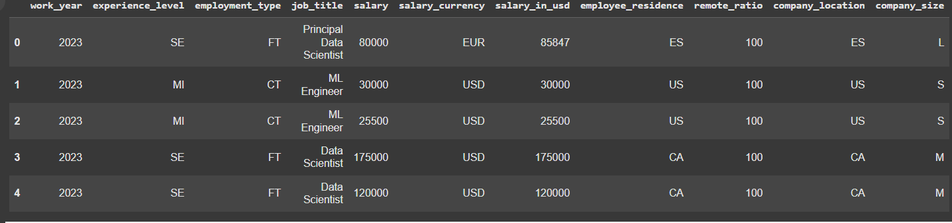
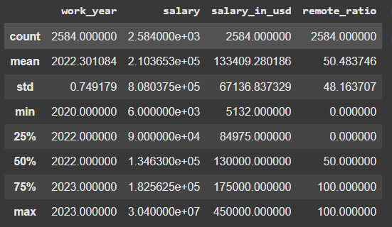
Initial Data Exploration
Rows & Columns: 3755 rows × 11 columns.
Data Types: Mix of categorical and numerical columns.
Sample Rows:
Stats Summary: df.describe().
Top Categorical Columns: Job Title, Experience Level, Company Size, Employment Type.

Slide 4
Handling Missing & Duplicate Data
01
02
03
Missing Values: Dataset had 0 missing values
Duplicates:
Found 1171 duplicates
Data Type Fixes:
Converted columns like ‘company_size’ and ‘experience_level’ to categorical for better analysis.

Slide 5
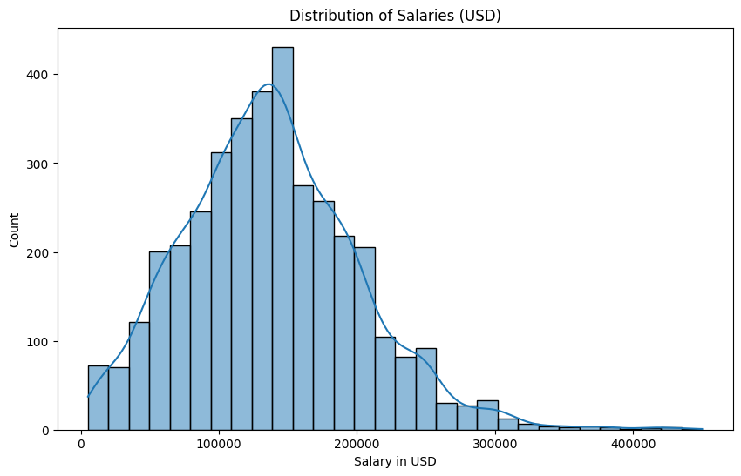
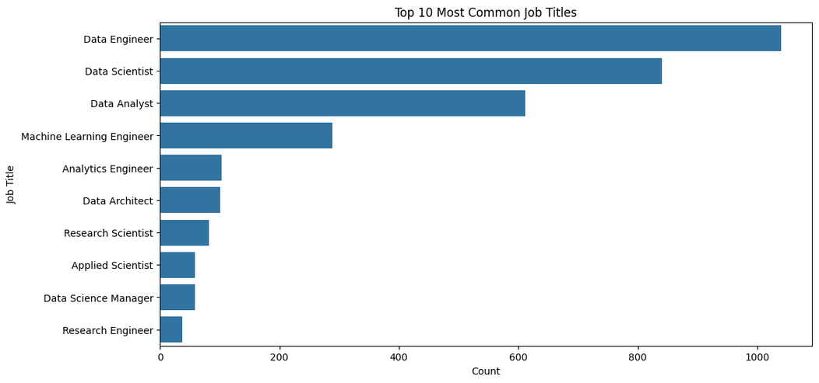
Exploring the Data with Plots
Countplot of Job Titles – Most common roles in data science.
.
Histogram for salary distribution

Slide 6
New Features & Their Impact
Created new feature named salary to Experience ratio
A normalized salary metric that adjusts for experience level: salary_exp_ratio = salary_in_usd experience_weight, where experience levels are mapped as: EN=1, MI=2, SE=3, EX=4.
Purpose: Helps identify if employees are compensated fairly relative to their seniority.
Creating Salaries bin
Salary categorized into discrete bins:
<60K, 60K–100K, 100K–150K, 150K–200K, >200K.
Purpose: Enables clearer segmentation of compensation levels for comparison across roles, departments, or regions.

Slide 7
Key Insights from EDA
1. Experience Drives Salary Growth
Insight:
Higher experience levels show wider salary ranges and more outliers (top-paying roles)
2. Company Size Matters Less Than Expected
Insight:
Density peaks overlap significantly across company sizes
3. Remote Work Correlates with Higher Pay
Insight:
High-density cluster at 100% remote with salaries >$150K*

